Slide 1
Year 6
Relationships
Lesson 2

Slide 2
PSHE
What does PSHE stand for?
Personal
Social
Health
Economic

Slide 4
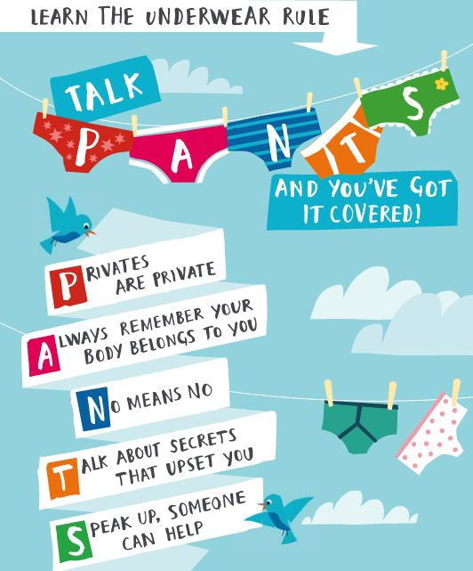

Slide 5
R - Respect
O – Openness
C – Confidential
K - Kind
Notes:
‹#›

Slide 6
Learning objective:
To explore positive and negative ways of communicating in relationships
To understand healthy relationships

Slide 8
Year 6
Relationships
Lesson 3

Slide 9
PSHE
What does PSHE stand for?
Personal
Social
Health
Economic

Slide 12
R - Respect
O – Openness
C – Confidential
K - Kind
Notes:
‹#›

Slide 13
Learning objective:
To recap the male and female changes that happen during puberty
To understand what makes a family and who to turn to for help and support

Slide 14
What is puberty?
Puberty is the time when your body changes from being a child to a young adult.

Slide 15
Why does it happen?
Puberty starts when extra amounts of chemicals called hormones start to be produced in the body.
The body produces the hormones OESTROGEN, PROGESTOGEN and TESTOSTORONE which are responsible for many different changes in the body.

Slide 16
Physical Changes
Physical changes happen because the body starts to produce chemicals called hormones; oestrogen, progesterone and testosterone.
Puberty can happen anywhere between 8 and 18 years of age.

Slide 17
What changes happen to girls?
Get taller
Bones grow bigger and heavier
Hips get wider and more curvy
Hair and skin can become oily and you may get spots
Body sweats more
Face changes shape
Voice gets a little deeper
Hair grows under the armpits, around the genitals (pubic hair)
Hair on arms and legs grows darker
Breasts and nipples get larger
May have mood swings
Period starts

Slide 18
What changes happen to boys?
Get taller
Bones grow bigger and heavier
Hair and skin can become oily and you may get spots
Body sweats more
Face changes shape - Nose and jaw get bigger and face gets longer
Get more muscles
Hair grows on the face, under the armpits, around the genitals (pubic hair).
May get more hair on arms, legs and chest.
Voice gets deeper
Penis and testicles grow bigger and longer
May have mood swings

Slide 19
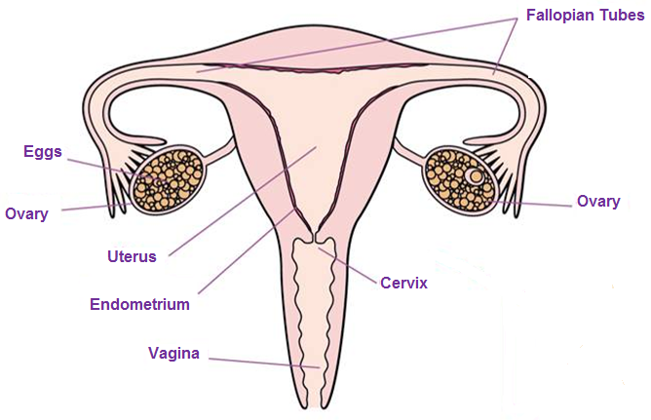
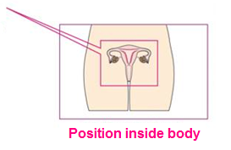
The Female Reproductive System

Slide 20
The Period
Bleeding can last between 3 and 8 days.
Blood flow may be heavier in the first few days.
The average blood loss is only around 80ml (roughly 3 tablespoons)

Slide 21
The Menstrual Cycle
Days 1-7 are the beginning of the cycle when the
lining of the womb is shed (Period).
Days 7-14 are when the egg is being produced within the ovary. It is then released into the fallopian tube to make its way down to the womb
Days 14-28 are when the lining of the womb becomes thicker in blood supply to protect the egg.

Slide 22
What symptoms are there?
Many girls will feel other symptoms during or before their period. These can include:
Tender breasts
Headaches
Mood swings
Stomach cramps
Tiredness
Spots
Food cravings
Difficulty concentrating

Slide 23
Planning
Periods will not have a set pattern in the beginning, they will eventually settle into their own pattern.
Periods happen once a month but your body takes time do get into a routine so for the first year or so the time between each period may vary.
You should carry some spare underwear and sanitary towels in your bag in case your period comes unexpectedly.

Slide 24
What do I use?
Most girl’s will wear a sanitary towel when they have a period. It is placed within the knickers and it works by soaking up the blood.
It is important to change the sanitary towels every 3-4 hours. This helps you to stay clean and fresh.

Slide 25
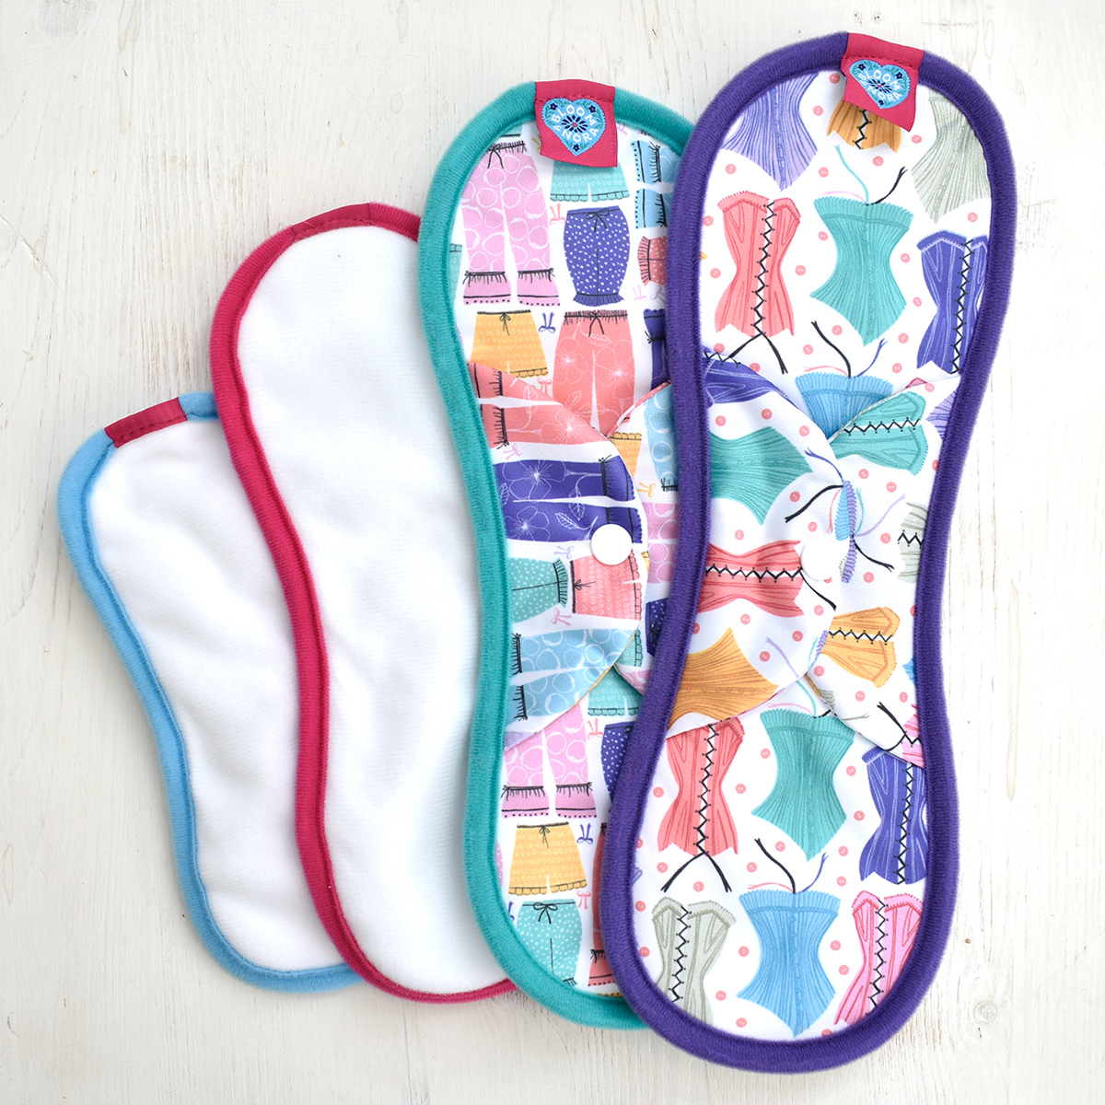
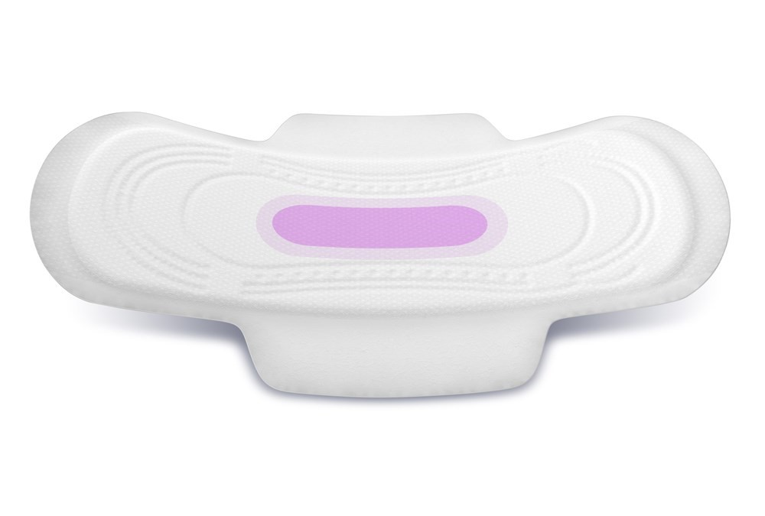

Slide 26
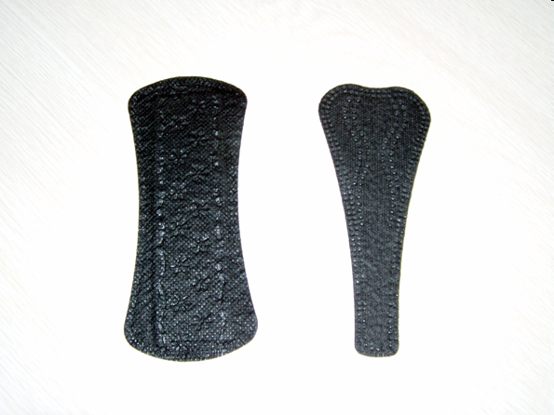
Pantiliners
Worn outside your body, in your underwear
Can be used:
When your period is light
As tampon backup
In between periods to absorb discharge
To help keep you fresh every day

Slide 27
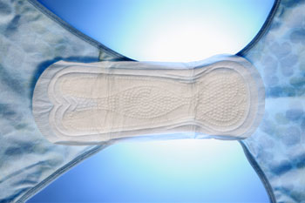
Sanitary Towel
Worn outside your body, in your underwear.
Many different absorbencies.
Wings provide extra protection.
Change frequently to keep fresh and dry (generally every 4-6 hours, more often when your period is heavy).
They will start to leak if you don’t change them!

Slide 28
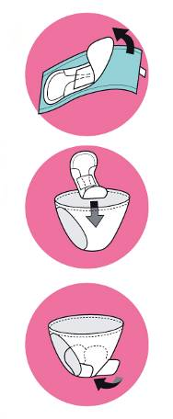
How to use a sanitary towel
Pull off paper strip or wrapper.
Attach sticky part securely to centre of underwear.
For wings, peel off paper strips and wrap around sides of underwear.

Slide 29
Emotional Changes
It is not just your body that changes during puberty – your mind and feelings change too.
Sometimes:
You may feel lonely and confused.
You may have mood swings (including irritability, tearfulness, overwhelming happiness and confusion).
You may want more independence.
You may also become argumentative and bad tempered.

Slide 30
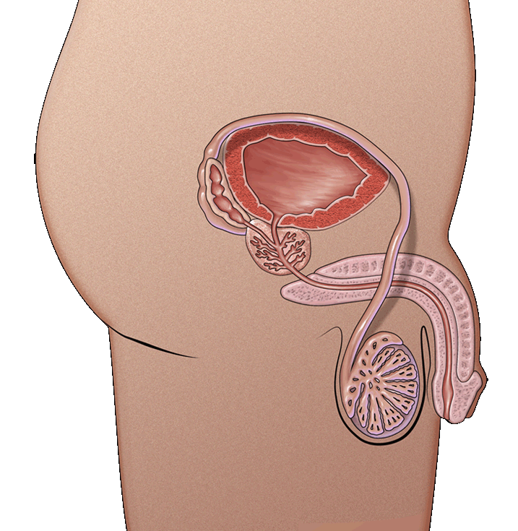
Penis Anatomy
Urethra
The tube through which urine and semen leaves the boy’s body
Penis
Tube-like organ that hangs outside the body
Come in all sizes and shapes, determined by our genes
Testicles or testes
Usually two, one hangs lower
Where sperm are made
Scrotum
Bag of skin that holds testicles
Keeps them at right temperature to make sperm, slightly cooler than body’s temperature
Gets bigger and baggier and turns a darker colour during puberty

Slide 31
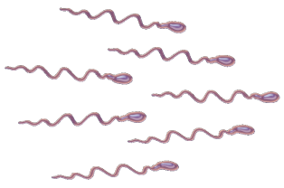
The reason boys have a reproductive system is because it provides
the sperm needed to fertilise a female’s egg.
We will learn more about fertilisation in the next lesson.
During puberty the levels of the hormone testosterone in your body begin to rise. This causes the penis and testicles to get bigger and the testicles to produce sperm.
The testicles cannot make sperm before puberty.
Sperm look like tadpoles, with what appear to be a head and a tail.

Slide 32
Erections
An erection happens when extra blood flows to the penis. This causes the penis to harden and lengthen.
Most erections are not straight, and tend to either curve upwards or to either side.
Erections can happen at any time. This is not an unusual change and happens to boys.

Slide 33
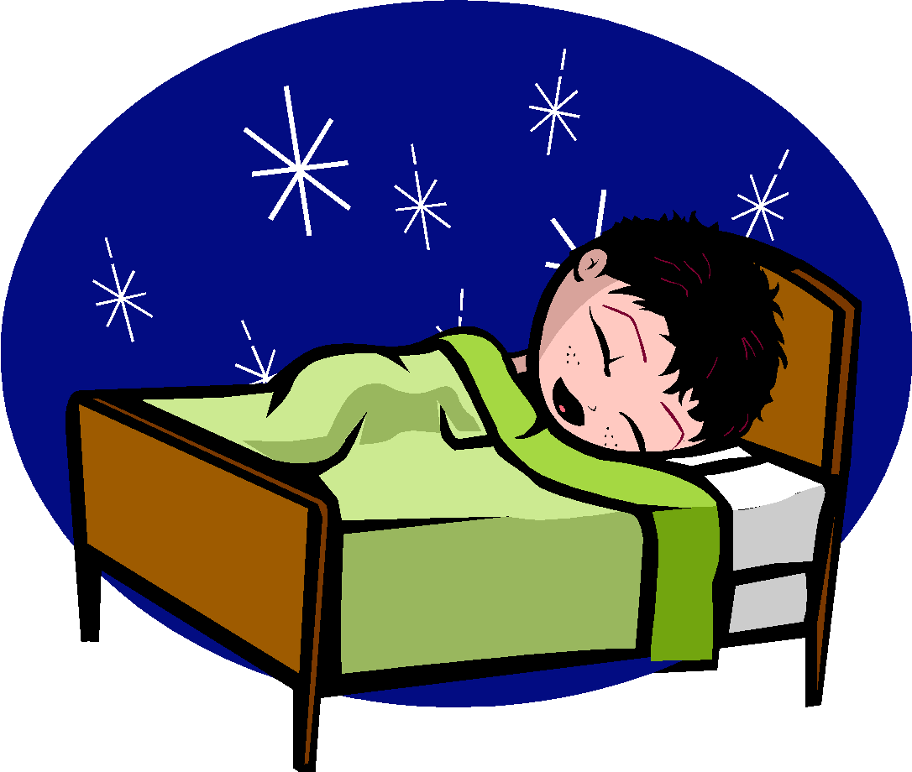
Wet dreams
Sometimes sperm will leave your body, through your urethra when you are asleep.
This is called a nocturnal emission, more commonly known as a “wet dream.”
It happens without you knowing about it.
You may notice that your pyjamas or sheets feel wet or sticky when you wake up.
Most males experience wet dreams between the ages of 12 to 18.
Wet dreams are a normal change that happen during puberty.
You will experience wet dreams less frequently as you grow older, you will have more control over your body.

Slide 34
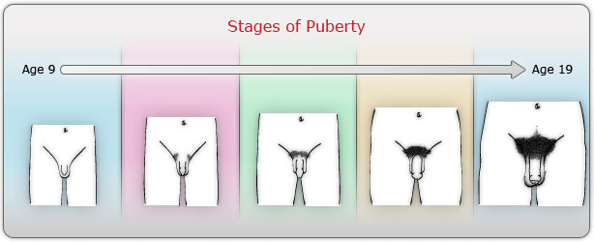
Penis and Testicles
Your penis and testicles will grow bigger and longer. Sometimes one testicle grows faster than the other, and it is natural for one to hang lower than the other.
Pubic hair, will also start to grow at the base of the penis. As you get older, this hair will grow thicker and courser.
Penises come in all shapes and sizes and all are very different. Your penis also doesn’t stop growing until you reach the ages of 18 to 21.

Slide 35
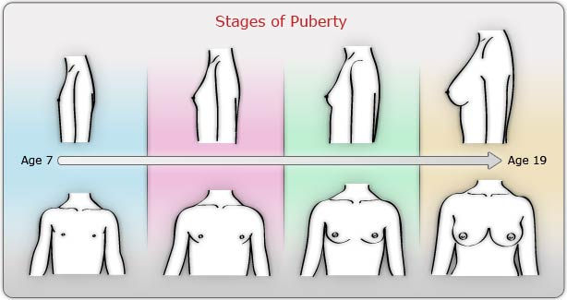
Breasts
Your genes determine the size and shape of breasts.
The first thing you may notice is a bump behind the nipple.
Then there will be swelling underneath
The nipple area gets darker.
Breasts grow slowly and one side may be bigger for awhile.
They may feel sore at times while they are developing.

Slide 36
The hardest thing about growing up is… The thing I am looking forward to about growing up is…

Slide 38
Year 6
Relationships
Lesson 4 - Non Statutory Sex Education

Slide 39
PSHE
What does PSHE stand for?
Personal
Social
Health
Economic

Slide 42
R - Respect
O – Openness
C – Confidential
K - Kind
Notes:
‹#›

Slide 43
Learning objective:
The understand the human reproductive system

Slide 44
Conceive
Sperm
Egg

Slide 45
A man produces sperm in his testicles.
Once a month, the woman’s body releases an egg.
In order for the sperm to meet the egg a man and woman will have sexual intercourse.

Slide 46
During sexual intercourse, the sperm will enter a woman’s body via her vagina.
This sperm then travels through the woman’s body towards the fallopian tube.
In the fallopian tube, the sperm may meet with the egg. This is called fertilisation.
The fertilised egg will then travel to the uterus.

Slide 47
The lining of the uterus will build up to protect the fertilised egg.
Remember is the egg was not fertilised, the woman would shed the lining of her uterus (as a period)
A fertilised egg takes 9 months to grow into a baby.
The woman carries the baby inside her womb.

Slide 48
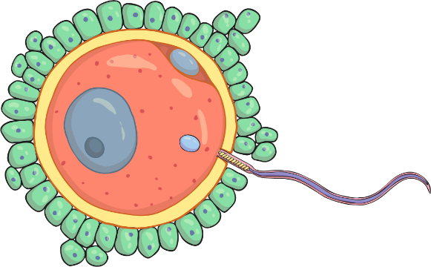
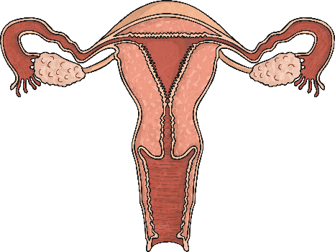
If a man and a woman want to conceive a baby, they have sexual intercourse. The man’s penis releases sperm into the woman’s vagina which race to find the woman’s egg.
The woman’s body releases one egg once a month. The egg only lives for about 12 – 24 hours and sperm can live for 5 – 7 days.
If a sperm reaches the egg, the egg is fertilised, starting a new life form

Slide 49
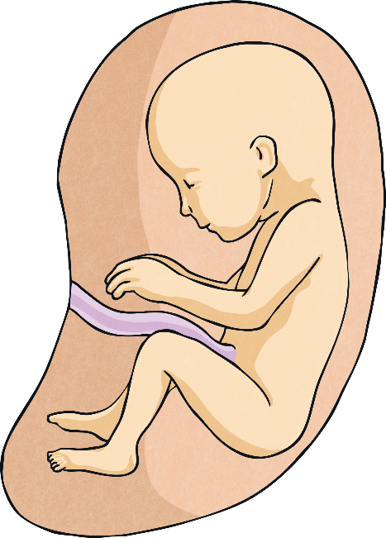
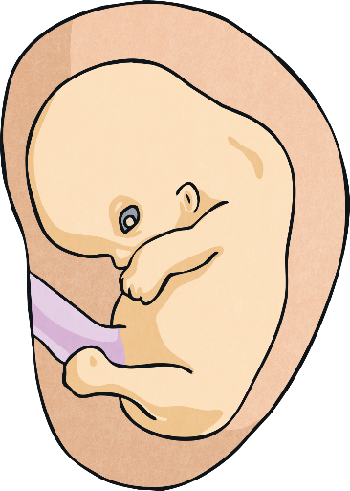
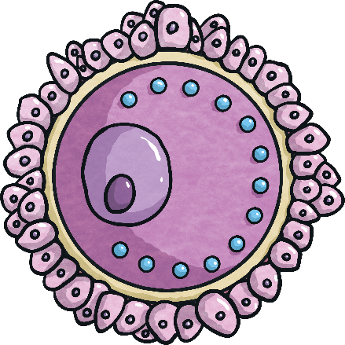
From Conception to Birth
Wow! From just two cells (a sperm and an egg) to 37.2 trillion cells in a human being!
zygote
embryo
foetus
The rate of growth is extremely rapid. The egg cell measures 0.12mm in diameter and a newborn baby is approximately 50cm.

Slide 50
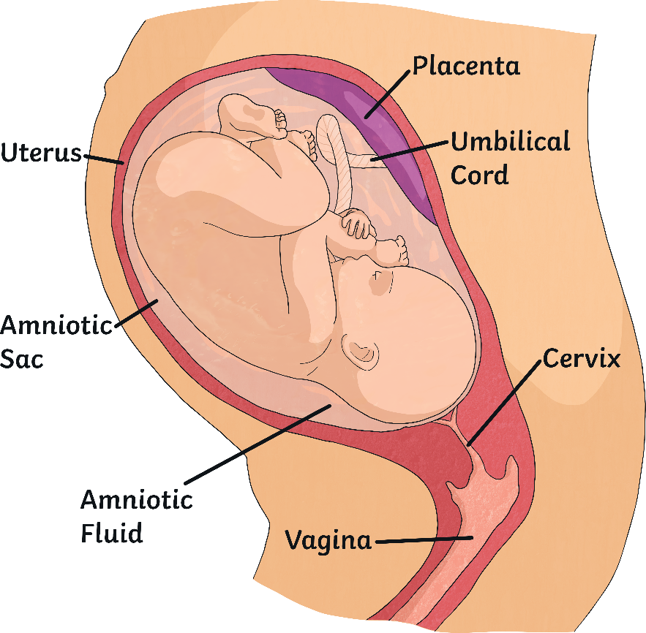
The foetus is protected in the uterus, inside an amniotic sac, which is filled with amniotic fluid.
All the nutrients that the foetus needs while it is inside the womb (or uterus), are passed from the mother’s body to the foetus.
The mother’s body creates a placenta. Nutrients and oxygen pass from the placenta, through the umbilical cord to the baby.

