Slide 1
Learning objective:
To understand how to keep myself clean and healthy and explain why it is important.

Slide 2
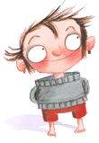
Say “Hello” to
Hello
Hello Year 1
My name is
Dirty Bertie!
Hello
Hello
I’m going to
tell you about
myself.

Slide 3
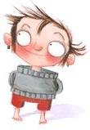
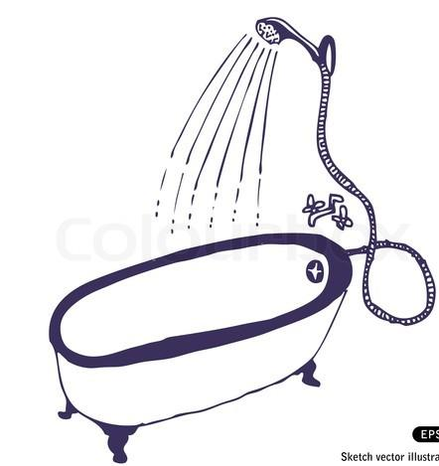
I don’t like baths
or showers...
YUK!

Slide 4
I never clean
my teeth...
NO WAY!

Slide 5
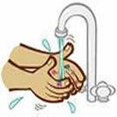
I don’t bother
washing my hands
after I go to the
toilet or before I
eat...
WHY BOTHER?

Slide 6
I can’t be bothered
to use a tissue
when I sneeze..
SO WHAT?

Slide 7
That’s ok isn’t it?
No?
Why not?
Can you help me please?

Slide 8
Why is it important to:
Have a bath or a shower regularly?
Brush our teeth twice a day?
Wash our hands?
Sneeze into a tissue?

Slide 9
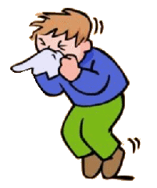
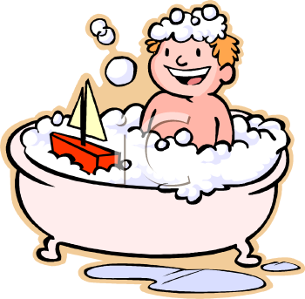
Bertie’s promise:
I will have a bath or shower when my parents tell me to.
I will clean my teeth after my breakfast and before I
go to bed.
3. I will wash my hands after I go to the toilet and before
I eat.
4. I will use a tissue when I sneeze.

Slide 10
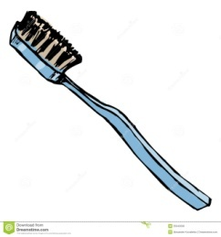
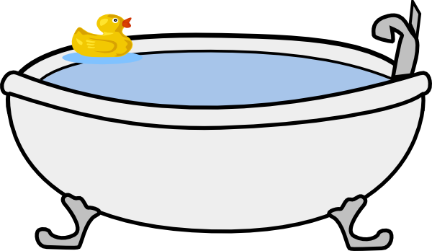
Thank you for your
help everyone!
I’m much cleaner
and healthier now!

Slide 11
Year 1
Relationships
Lesson 10

Slide 12
PSHE
What does PSHE stand for?
Personal
Social
Health
Economic

Slide 14
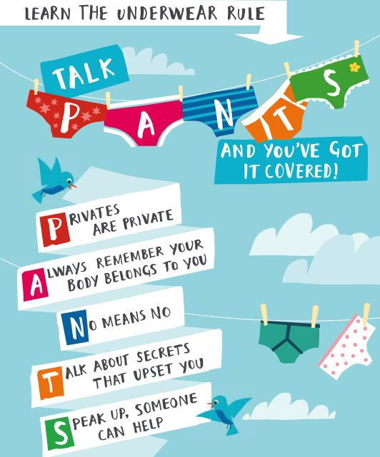

Slide 15
R - Respect
O – Openness
C – Confidential
K - Kind
Notes:
‹#›

Slide 16
Learning objective:
To understand how I have grown and changed since birth

Slide 17
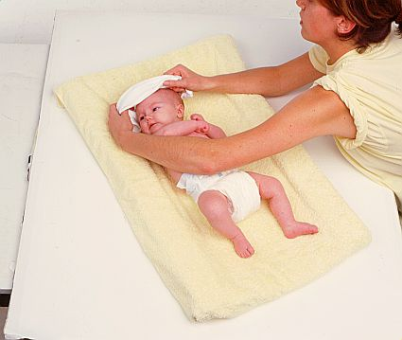
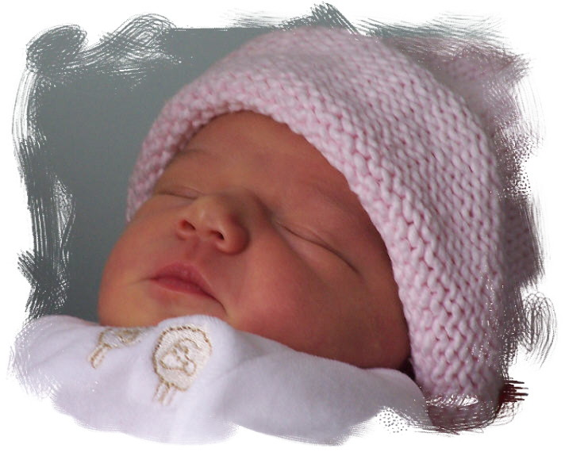
Babies
Babies can do nothing for themselves when they are first born
How do we feed babies?

Slide 18
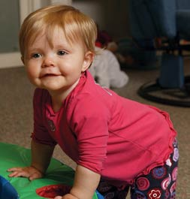
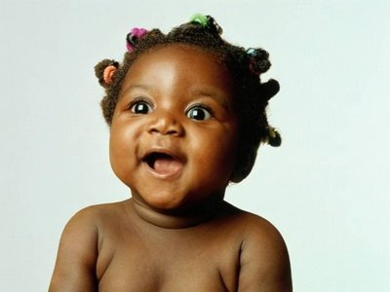
Toddler
A toddler is a very young child who is just learning to walk.
Toddlers are a bit wobbly on their feet!

Slide 19
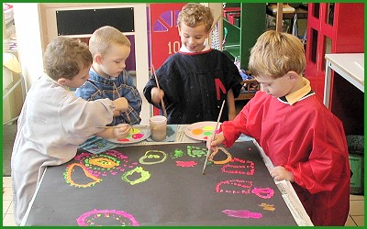
Children
As babies grow they turn into toddlers, then children.
Children learn to do things for themselves.

Slide 20
Year 1
Relationships
Lesson 11

Slide 21
PSHE
What does PSHE stand for?
Personal
Social
Health
Economic

Slide 24
R - Respect
O – Openness
C – Confidential
K - Kind
Notes:
‹#›

Slide 25
Learning objective:
To identify the people in my family, while recognising that not all families look like mine
To explain where I can get help and support

Slide 26
Who can help?

