Slide 1
Year 5
Relationships
Lesson 2

Slide 2
PSHE
What does PSHE stand for?
Personal
Social
Health
Economic

Slide 4
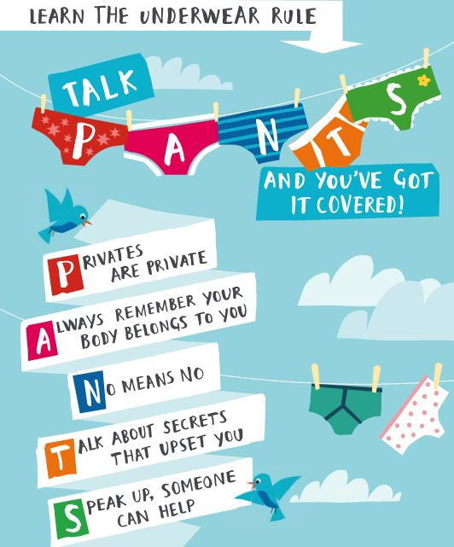

Slide 5
R - Respect
O – Openness
C – Confidential
K - Kind
Notes:
‹#›

Slide 6
Learning objective:
To explore the emotional and physical changes that occur during puberty
To understand male and female puberty changes
To explore the impact of puberty on the body and the importance of physical hygiene
To explore ways to get support during puberty

Slide 7
What is puberty?
Puberty is changing, growing and maturing from a child to an adult.
What are the stages of the human lifecycle?

Slide 8
Baby
Toddler
Child
Teenager
Adult
Elder
Puberty happens between the child and teenager stage. It prepares us for becoming an adult

Slide 9
What is puberty?
Puberty is the time when your body changes from being a child to a young adult.

Slide 10
Why does it happen?
Puberty starts when extra amounts of chemicals called hormones start to be produced in the body.
The body produces the hormones OESTROGEN, PROGESTOGEN and TESTOSTORONE which are responsible for many different changes in the body.

Slide 11
Physical Changes
Physical changes happen because the body starts to produce chemicals called hormones; oestrogen, progesterone and testosterone.
Puberty can happen anywhere between 8 and 18 years of age.

Slide 12
Physical Changes
The female body mainly produces progesterone and oestrogen which start the changes of puberty.
Usually starts between 8-13 years.
The male body mainly produces testosterone which start the changes of puberty.
Usually stars between 10-15 years.
Sperm is produced

Slide 13
What changes happen to girls?
Get taller
Bones grow bigger and heavier
Hips get wider and more curvy
Hair and skin can become oily and you may get spots
Body sweats more
Face changes shape
Voice gets a little deeper
Hair grows under the armpits, around the genitals (pubic hair)
Hair on arms and legs grows darker
Breasts and nipples get larger
May have mood swings
Period starts

Slide 14
What changes happen to boys?
Get taller
Bones grow bigger and heavier
Hair and skin can become oily and you may get spots
Body sweats more
Face changes shape - Nose and jaw get bigger and face gets longer
Get more muscles
Hair grows on the face, under the armpits, around the genitals (pubic hair).
May get more hair on arms, legs and chest.
Voice gets deeper
Penis and testicles grow bigger and longer
May have mood swings

Slide 15
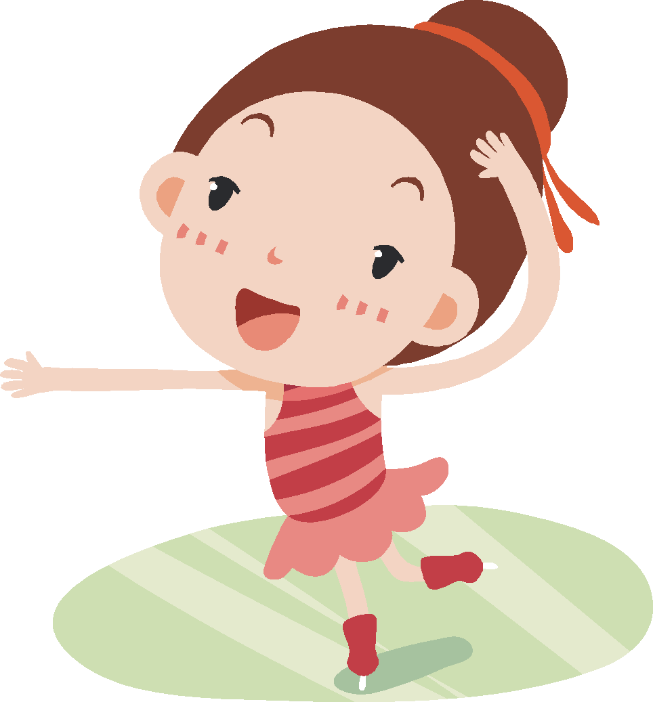
Periods
What Happens & Why?

Slide 16
When will my periods start?
Usually when you are between 10 - 16 years but you could be anything from 8 to 18 years.
Your periods will start when your body is ready. You can’t make them start or stop them from starting.

Slide 17
Why do I have periods?
Periods are caused by hormone levels changing within your body.
It is natures way of preparing your body adult hood

Slide 18
What happens?
Even before birth, a girl has 1-2 million tiny eggs in her ovaries. When puberty is reached usually an egg is released each month from her ovaries.
The egg moves from the ovary and along the fallopian tube and down into the (womb) uterus.
The lining of the womb is thick and gets thicker to protect the egg. When the egg does not need to be protected anymore and the egg and uterus lining leave your body through your vagina; this is your period.

Slide 19
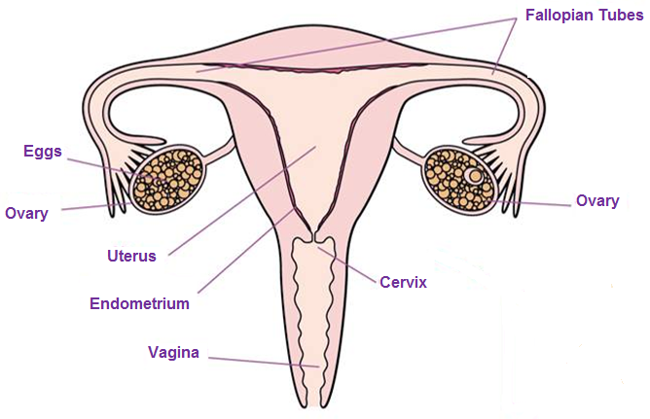
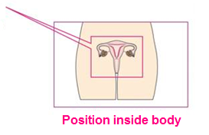
The Female Reproductive System

Slide 20
The Period
Bleeding can last between 3 and 8 days.
Blood flow may be heavier in the first few days.
The average blood loss is only around 80ml (roughly 3 tablespoons)

Slide 21
The Menstrual Cycle
Days 1-7 are the beginning of the cycle when the
lining of the womb is shed (Period).
Days 7-14 are when the egg is being produced within the ovary. It is then released into the fallopian tube to make its way down to the womb
Days 14-28 are when the lining of the womb becomes thicker in blood supply to protect the egg.

Slide 22
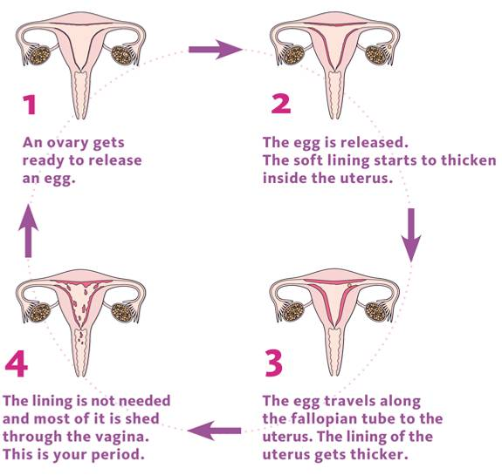
Notes:
‹#›

Slide 23
When will my period start?
Usually between 10-16 years old
About 2 years after your breasts develop
Soon after you grow pubic hair
REMEMBER – every girl is different!

Slide 24
What symptoms are there?
Many girls will feel other symptoms during or before their period. These can include:
Tender breasts
Headaches
Mood swings
Stomach cramps
Tiredness
Spots
Food cravings
Difficulty concentrating

Slide 25
Planning
Periods will not have a set pattern in the beginning, they will eventually settle into their own pattern.
Periods happen once a month but your body takes time do get into a routine so for the first year or so the time between each period may vary.
You should carry some spare underwear and sanitary towels in your bag in case your period comes unexpectedly.

Slide 26
What do I use?
Most girl’s will wear a sanitary towel when they have a period. It is placed within the underwear and it works by soaking up the blood.
It is important to change the sanitary towels every 3-4 hours. This helps you to stay clean and fresh.

Slide 27
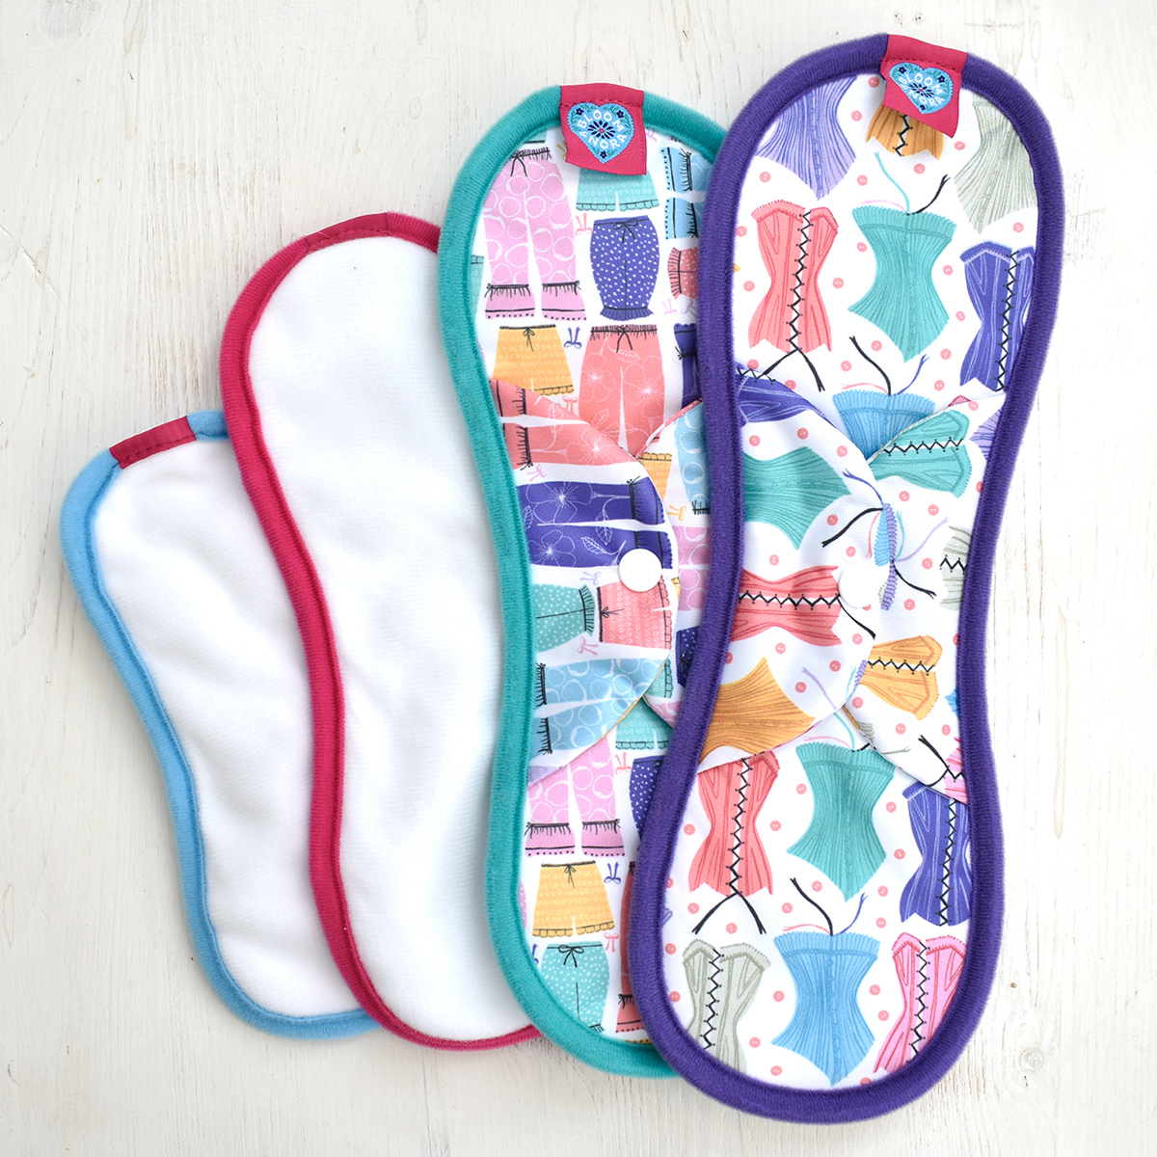
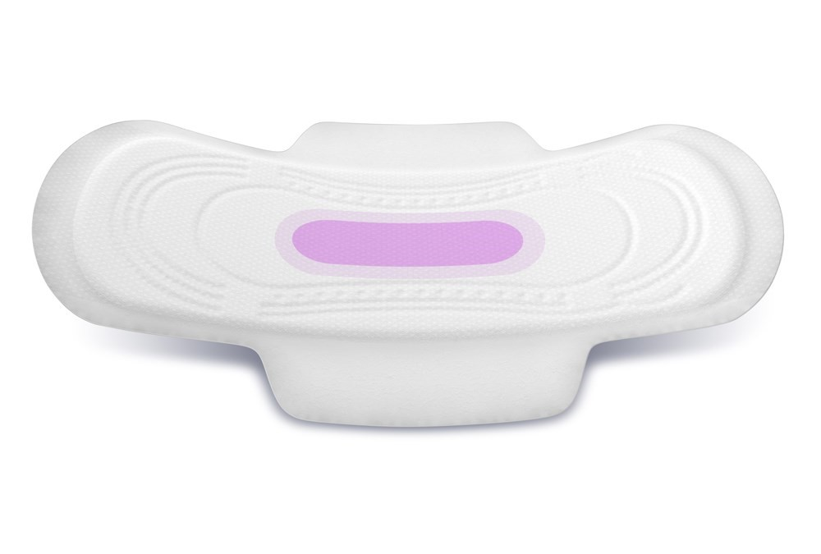

Slide 28
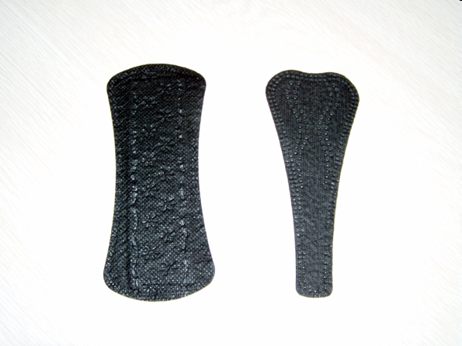
Pantiliners
Worn outside your body, in your underwear
Can be used:
When your period is light
As tampon backup
In between periods to absorb discharge
To help keep you fresh every day

Slide 29
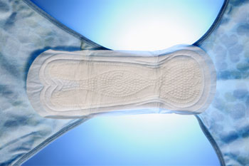
Sanitary Towel
Worn outside your body, in your underwear.
Many different absorbencies.
Wings provide extra protection.
Change frequently to keep fresh and dry (generally every 4-6 hours, more often when your period is heavy).
They will start to leak if you don’t change them!

Slide 30
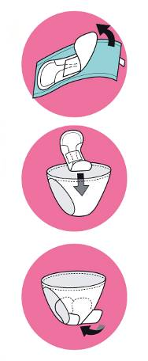
How to use a sanitary towel
Pull off paper strip or wrapper.
Attach sticky part securely to centre of underwear.
For wings, peel off paper strips and wrap around sides of underwear.

Slide 31
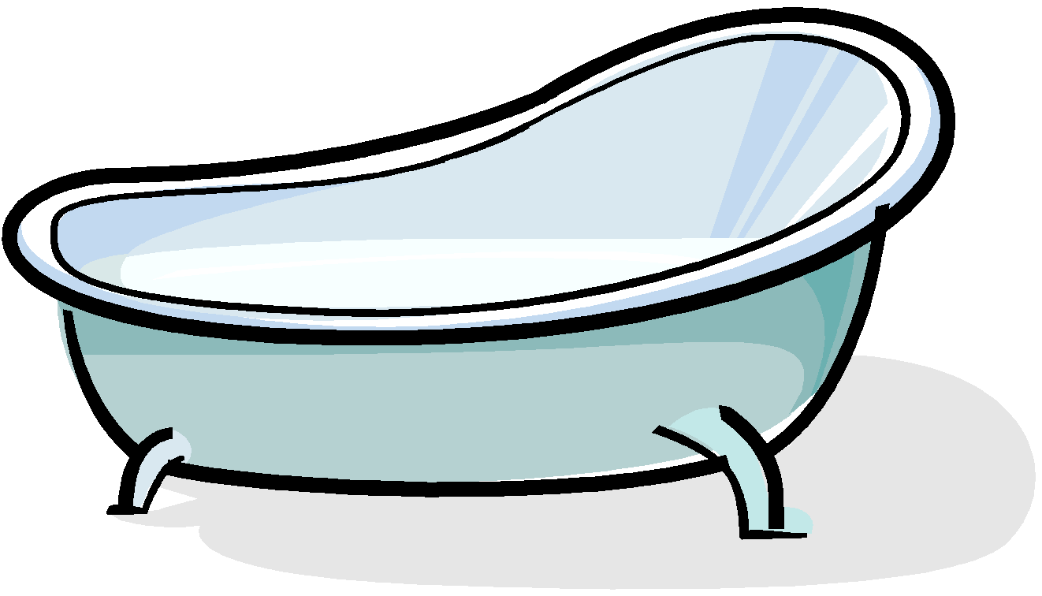
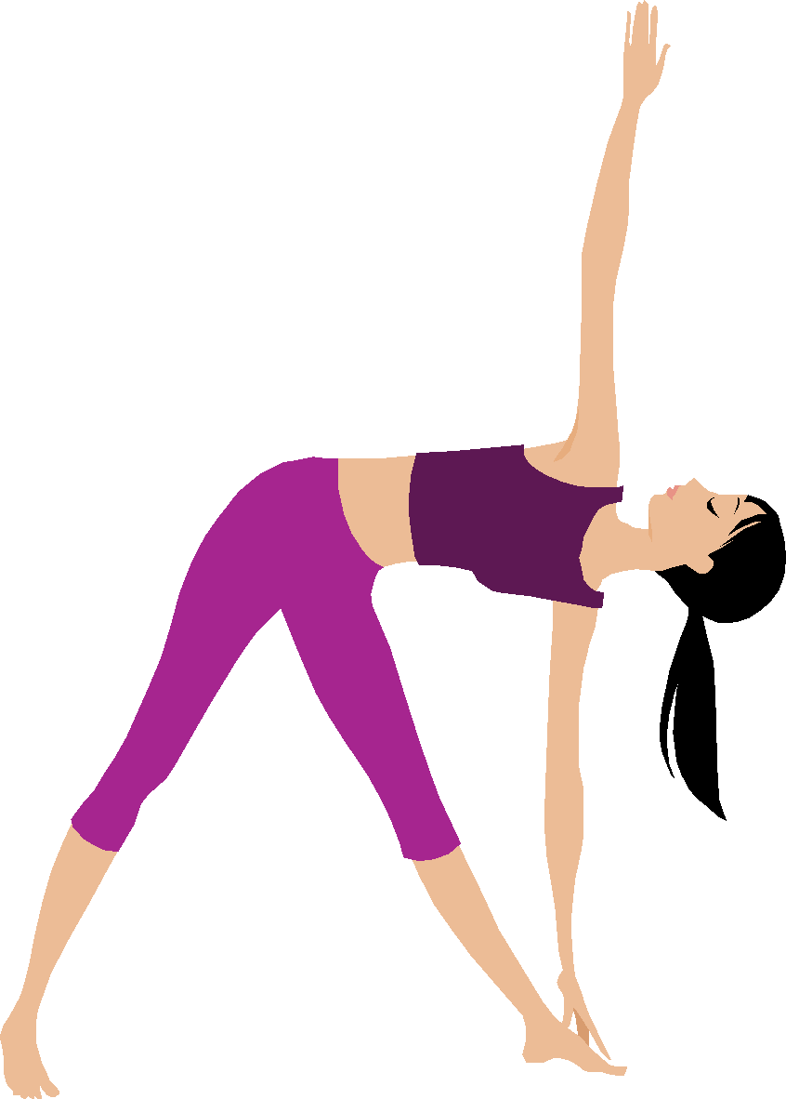
Things to try…
Have a warm bath
Massage your stomach
Have a nice warm drink
Use a hot water bottle or use a heat pad.
Eat a well balanced diet.
Exercise

Slide 32
Remember
Having a period is a normal healthy thing to happen.
It is a natural process for every girl/teenager/woman.
It can take some time getting used to having periods and feeling confident about dealing with them.
Periods are a sign that your body is working properly, they are a special part of being a female.

Slide 33
Questions
I’ve just turned 11 but nothing is happening yet. When will I start puberty?
Why are these changes happening to me?
I feel a bit scared about puberty, is this normal?

Slide 34
Year 5
Relationships
Lesson 3

Slide 35
PSHE
What does PSHE stand for?
Personal
Social
Health
Economic

Slide 38
R - Respect
O – Openness
C – Confidential
K - Kind
Notes:
‹#›

Slide 39
Learning objective:
To explore the emotional and physical changes that occur during puberty
To understand male and female puberty changes
To explore the impact of puberty on the body and the importance of physical hygiene
To explore ways to get support during puberty

Slide 40
What is puberty?
Puberty is the time when your body changes from being a child to a young adult.

Slide 41
Why does it happen?
Puberty starts when extra amounts of chemicals called hormones start to be produced in the body.
The body produces the hormones OESTROGEN, PROGESTOGEN and TESTOSTORONE which are responsible for many different changes in the body.

Slide 42
Physical Changes
Physical changes happen because the body starts to produce chemicals called hormones; oestrogen, progesterone and testosterone.
Puberty can happen anywhere between 8 and 18 years of age.

Slide 43
What changes happen to girls?
Get taller
Bones grow bigger and heavier
Hips get wider and more curvy
Hair and skin can become oily and you may get spots
Body sweats more
Face changes shape
Voice gets a little deeper
Hair grows under the armpits, around the genitals (pubic hair)
Hair on arms and legs grows darker
Breasts and nipples get larger
May have mood swings
Period starts

Slide 44
What changes happen to boys?
Get taller
Bones grow bigger and heavier
Hair and skin can become oily and you may get spots
Body sweats more
Face changes shape - Nose and jaw get bigger and face gets longer
Get more muscles
Hair grows on the face, under the armpits, around the genitals (pubic hair).
May get more hair on arms, legs and chest.
Voice gets deeper
Penis and testicles grow bigger and longer
May have mood swings

Slide 45
The Female Reproductive System

Slide 46
The Period
Bleeding can last between 3 and 8 days.
Blood flow may be heavier in the first few days.
The average blood loss is only around 80ml (roughly 3 tablespoons)

Slide 47
The Menstrual Cycle
Days 1-7 are the beginning of the cycle when the
lining of the womb is shed (Period).
Days 7-14 are when the egg is being produced within the ovary. It is then released into the fallopian tube to make its way down to the womb
Days 14-28 are when the lining of the womb becomes thicker in blood supply to protect the egg.

Slide 48
What symptoms are there?
Many girls will feel other symptoms during or before their period. These can include:
Tender breasts
Headaches
Mood swings
Stomach cramps
Tiredness
Spots
Food cravings
Difficulty concentrating

Slide 49
Planning
Periods will not have a set pattern in the beginning, they will eventually settle into their own pattern.
Periods happen once a month but your body takes time do get into a routine so for the first year or so the time between each period may vary.
You should carry some spare underwear and sanitary towels in your bag in case your period comes unexpectedly.

Slide 50
What do I use?
Most girl’s will wear a sanitary towel when they have a period. It is placed within the knickers and it works by soaking up the blood.
It is important to change the sanitary towels every 3-4 hours. This helps you to stay clean and fresh.

Slide 52
Pantiliners
Worn outside your body, in your underwear
Can be used:
When your period is light
As tampon backup
In between periods to absorb discharge
To help keep you fresh every day

Slide 53
Sanitary Towel
Worn outside your body, in your underwear.
Many different absorbencies.
Wings provide extra protection.
Change frequently to keep fresh and dry (generally every 4-6 hours, more often when your period is heavy).
They will start to leak if you don’t change them!

Slide 54
How to use a sanitary towel
Pull off paper strip or wrapper.
Attach sticky part securely to centre of underwear.
For wings, peel off paper strips and wrap around sides of underwear.

Slide 55
Emotional Changes
It is not just your body that changes during puberty – your mind and feelings change too.
Sometimes:
You may feel lonely and confused.
You may have mood swings (including irritability, tearfulness, overwhelming happiness and confusion).
You may want more independence.
You may also become argumentative and bad tempered.

Slide 56
Sometimes these emotional changes can cause conflict with our parents.
You might fall out over things like:
Homework
Clothes
Games consoles (i.e. X-Box, PlayStation)
Internet usage
Music choices and volume
Friends
Bedroom
Choice of leisure activities

Slide 57
How can we resolve this conflict?
Keep them involved, tell them how you are feeling about things.
Ask their advice, listen and if you disagree tell them why.
Accept that they have the right to lay down some rules, be willing to meet them halfway.
Try not to lose your temper, if you show them you can accept when they say no, may be they will be willing to say yes in the future.
Help more around the house, without waiting to be asked!

Slide 58
Conflict with friends
Other friendships, new friends.
Misunderstandings, arguments.
Choice of things to do together.
The way they talk to you, making you feel bad about yourself.
They do not listen to you, they only talk about themselves.
Jealousy.

Slide 59
Managing conflict with friends
Try to not demand too much support and attention without giving some in return
Show mutual respect.
Be honest with them.
Remember your expectations for a good friendship.

Slide 60
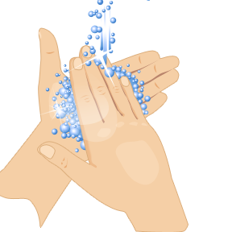
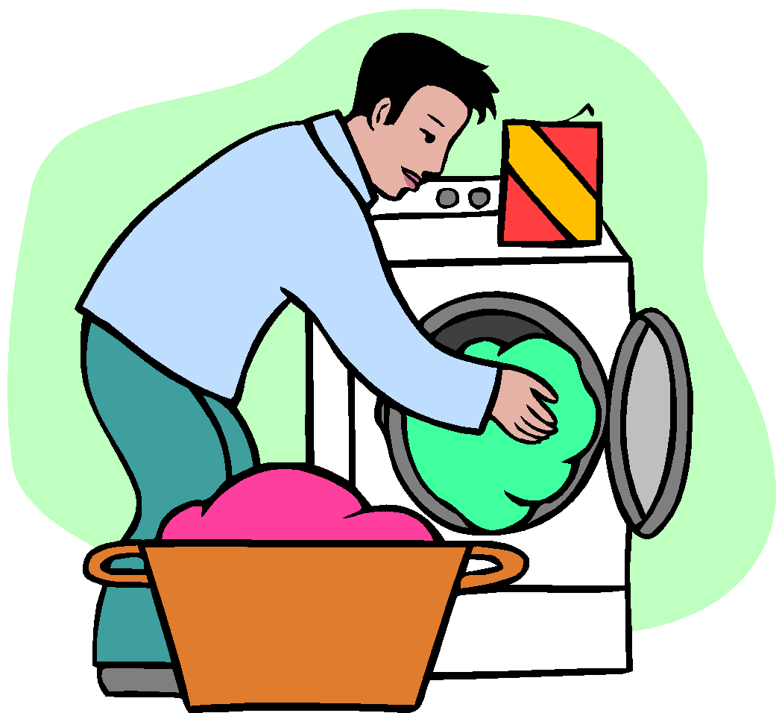
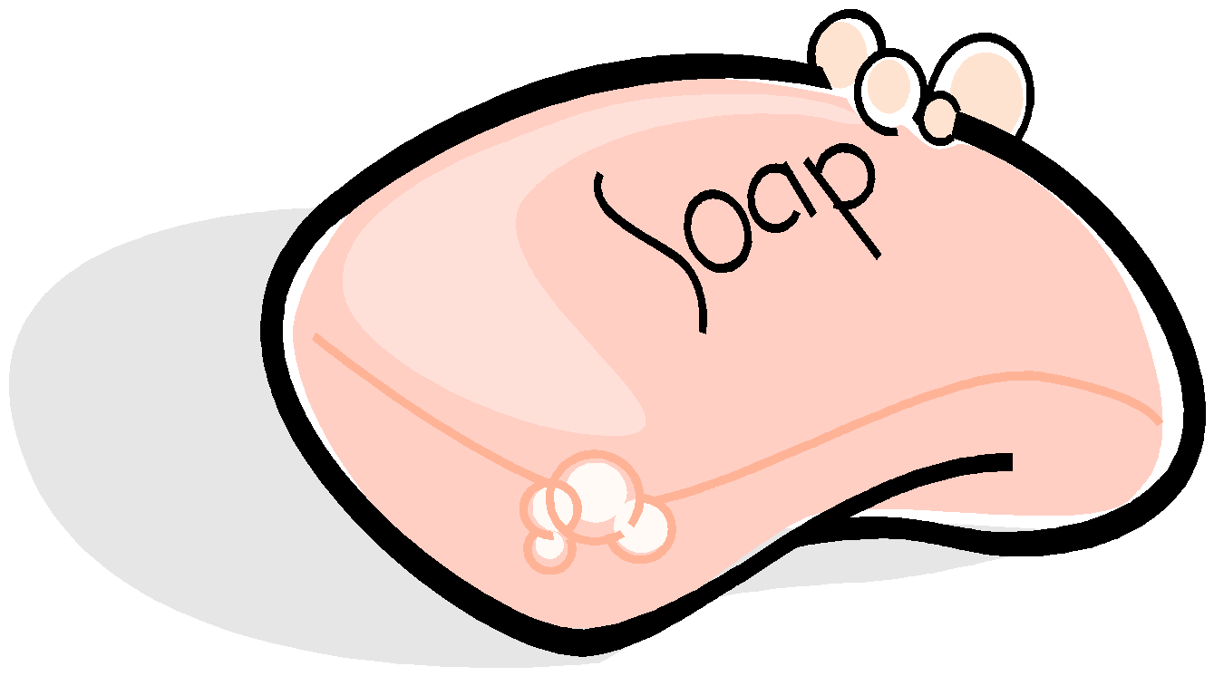
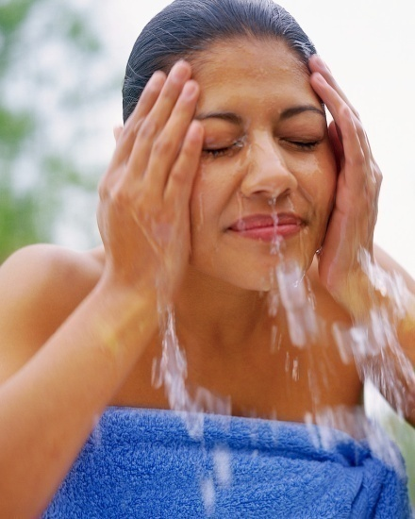
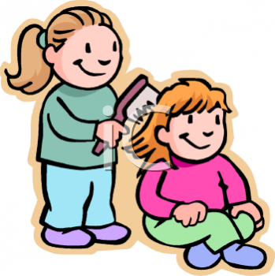
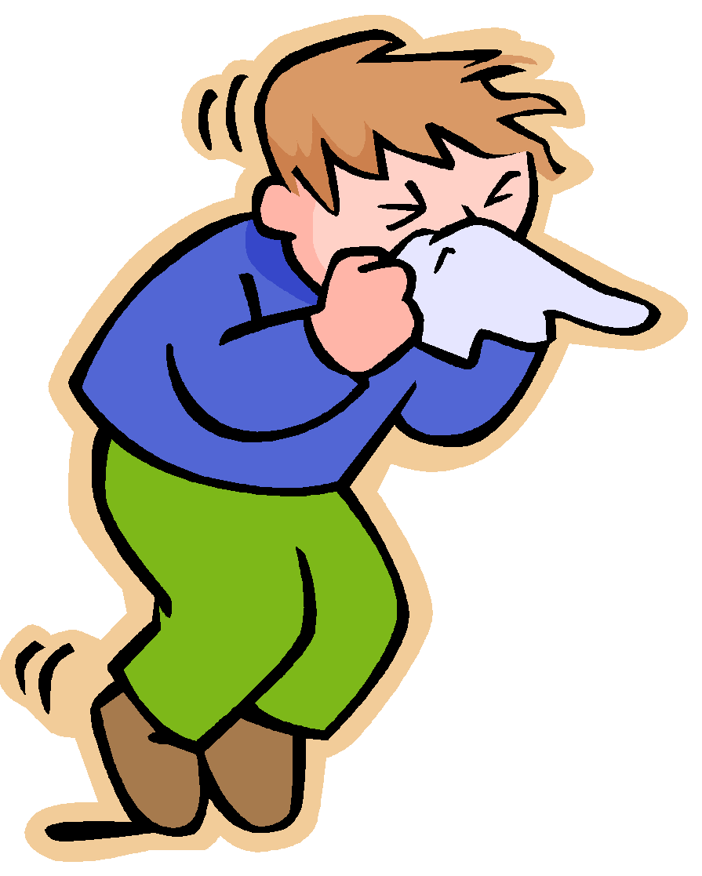
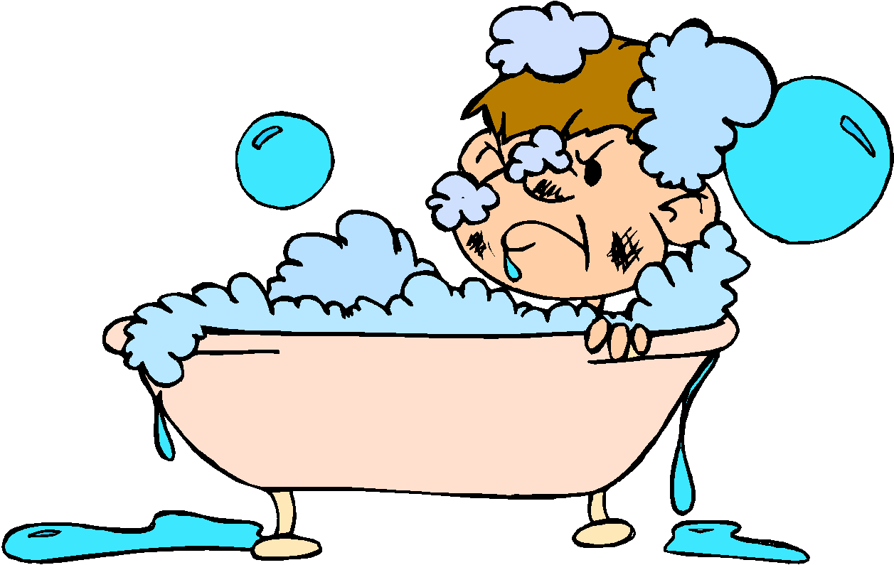
Notes:
‹#›
‹#›

Slide 61
Sweat
Sweat is your body’s natural way of helping you to cool down.
Sweat can also some times become smelly when the chemicals it contains mixes with bacteria that live naturally on your skin.
You will need to use a deodorant to manage sweat

Slide 62
Year 5
Relationships
Lesson 4

Slide 63
PSHE
What does PSHE stand for?
Personal
Social
Health
Economic

Slide 66
R - Respect
O – Openness
C – Confidential
K - Kind
Notes:
‹#›

Slide 67
Learning objective:
To understand what makes a family and who to turn to for help and support

Slide 71
Leo is struggling with his homework. He asks his mum for help but she is busy working. He shows it to his dad but his dad is busy making dinner. Keisha tells him to stop being annoying. Leo deliberately knocks a drink over and it spills on his sister’s book.

