Slide 1
Year 3
Relationships
Lesson 2

Slide 2
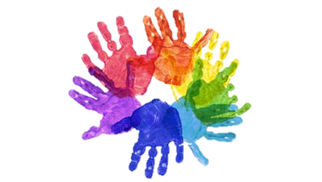
PSHE
What does PSHE stand for?
Personal
Social
Health
Economic

Slide 4
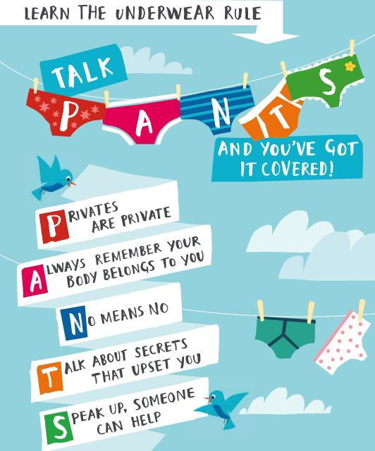

Slide 5
R - Respect
O – Openness
C – Confidential
K - Kind
Notes:
‹#›

Slide 6
Learning objective:
To understand how boys and girls are different and to name boy and girl body parts
To explain personal boundaries

Slide 7
Personal boundaries

Slide 9
Year 3
Relationships
Lesson 3

Slide 10
PSHE
What does PSHE stand for?
Personal
Social
Health
Economic

Slide 13
R - Respect
O – Openness
C – Confidential
K - Kind
Notes:
‹#›

Slide 14
Learning objective:
To identify the people in my family, while recognising that not all families look like mine
To explain where I can get help and support

Slide 15
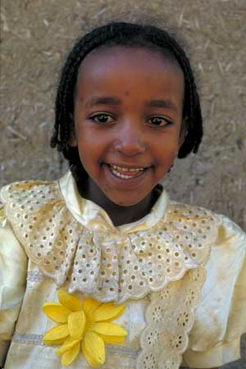
Notes:
‹#›
1. Muluken, who lives in Gerba Sefer village in Ethiopia.
Photo: Rhodri Jones/Oxfam
Muluken, who lives in Gerba Sefer village in Ethiopia. The village is high in the mountains in the eastern Highlands. Almost three-quarters of Ethiopia's land area is higher than Ben Nevis, the highest mountain in the UK.
Discussion: What links do pupils in the class have with Ethiopia? (family living there etc)

Slide 16
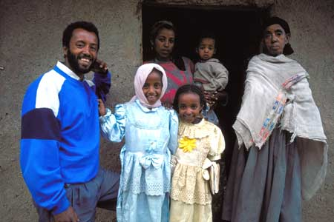
Notes:
‹#›
2. Muluken and her family.
Photo: Rhodri Jones/Oxfam
Muluken and her family. Muluken lives with her dad, her older sister Esketsenaf, and her younger sister Mekdes. Her grandmother also lives with them and takes care of the children while their mother is away. Muluken's mother works as a teacher in a school which is 20 kilometres away. It is difficult to travel so far every day, so she lives at home at weekends and during the school holidays.
Discussion: Extended family relationships; who lives at home/away from home etc.

Slide 17
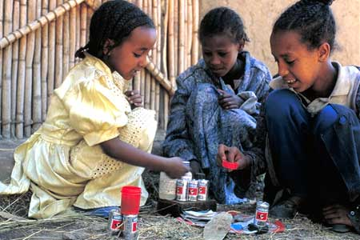
Notes:
‹#›
5. Muluken and her friends playing shop.
Photo: Rhodri Jones/Oxfam
Muluken and her friends playing shop. They find things around the home to 'buy and sell'. Muluken's uncle and his family live next door so there is always somebody to play with. Zebawork, Muluken's cousin, is like another big sister. Discussion: Games children play, who they play with, friends etc.

Slide 18
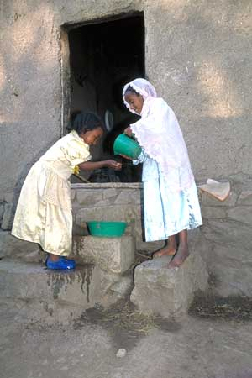
Notes:
‹#›
4. Muluken and her sister wash their faces and hands before breakfast.
Photo: Rhodri Jones/Oxfam
Muluken and her sister wash their faces and hands before breakfast. There is no running water in the house and so water has to be carried from the village pump. Luckily it is not too far. The pump is a good meeting place for the women of the village. One of Muluken's jobs is fetching water.
Discussion: Children's jobs around the home. You could relate this photo to number 17, which shows Sasha fetching water from the well. If Muluken's family carry water from the pump are they more likely to use water carefully? Do children in the UK use more water then they need to?

Slide 19
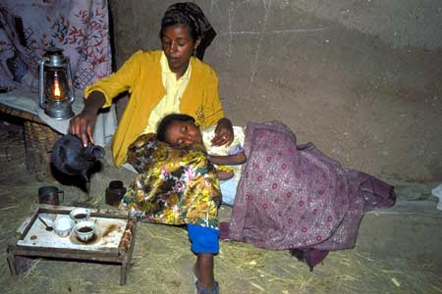
Notes:
‹#›
6. Muluken sleeps on her mother's lap.
Photo: Rhodri Jones/Oxfam
Muluken sleeps on her mother's lap. There is no electricity in Gerba Sefer village, and so the family use a paraffin lamp. At night it can get cold and it's sometimes frosty in November and December. Discussion: Do we waste power (eg electricity) in the North? What can we do to save energy at home?

Slide 20
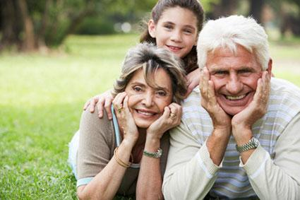
Notes:
‹#›
14. Every morning Sasha helps to dress his younger sister, Yulya.
Photo: Sarah Errington/Oxfam
Every morning Sasha helps to dress his younger sister, Yulya. His stepfather is often away working and Sasha likes to help his mother and babushka (Russian for grandmother) in every way he can. Christmas is a very important event in Russia. However, Russians celebrate it on 7th February, because the Russian Orthodox calendar is used. Discussion: Brothers and sisters; who helps who at home; important festivals etc.

Slide 21
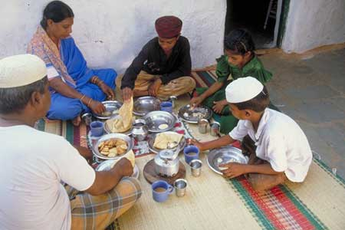
Notes:
‹#›
20. Shakeel and his family have breakfast.
Photo: Rajendra Shaw/Oxfam
Shakeel and his family have breakfast. They eat parathas, bread fried in oil, and drink tea. Shakeel likes lots of sugar in his tea! At 7 o'clock his dad gives him a lift to school in his auto-rickshaw, a taxi with three wheels. On the way Shakeel sees lots of monkeys. Discussion: What do the children eat for breakfast? Healthy eating and the importance of having breakfast.

Slide 22
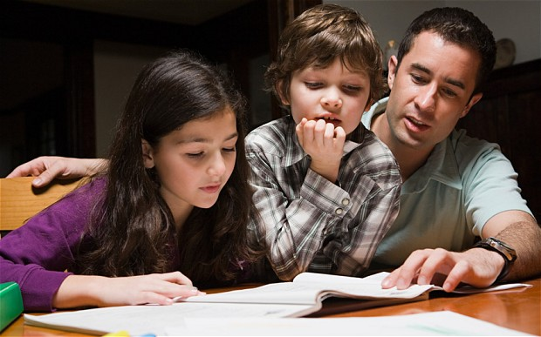

Slide 24
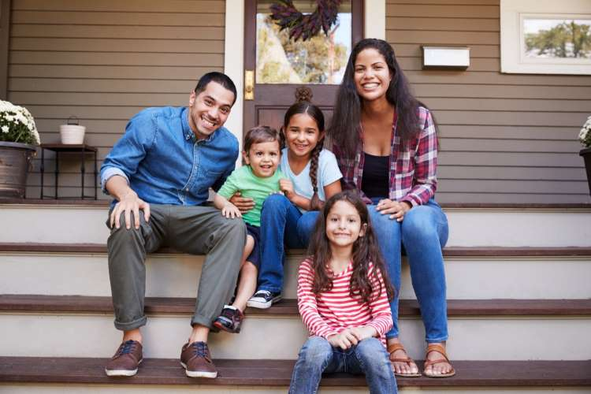

Slide 25
Year 3
Relationships
Lesson 4

Slide 26
PSHE
What does PSHE stand for?
Personal
Social
Health
Economic

Slide 29
R - Respect
O – Openness
C – Confidential
K - Kind
Notes:
‹#›

Slide 30
Learning objective:
To understand good friendships

Slide 31
https://www.bbc.co.uk/bitesize/clips/zjstsbk

